Slide 1
MEMORI
Ps Softwarearchitecture

Slide 2


Milestones& Deadlines
Milestone 1 Dec 4, 2022–Dec 12, 2022
implement Classes ACCORDING TO UML- Diagram, Database planning , RepositorIES ERSTELLEN,
Milestone 2 Dec 12, 2022–Jan 9, 2023
Logik, Back-End
Milestone 3 Jan 9, 2023–Jan 16, 2023
SIMPLE Frontend fertig stellen, Benutzerfreundlichkeit IMPROVEMENT
Milestone 4 Jan 16, 2023–Jan 23, 2023
Testing, Final Refactoring, SonarQube, Presentation preparation

Slide 3
ZEITACHSE
1. Milestone | Reached all of our goals.
2. Milestone | We changed our strategie and worked on both Front- & Backend mutally
3. Milestone | We could not reach all of our Goals + We lost an Partner
4. Milestone | Reached almost all our goals, except good testing coverage
Result Resume | Self assessment with timing was not as expected, some things took more time than we expected but in the end we meet all project requirments.

Slide 4
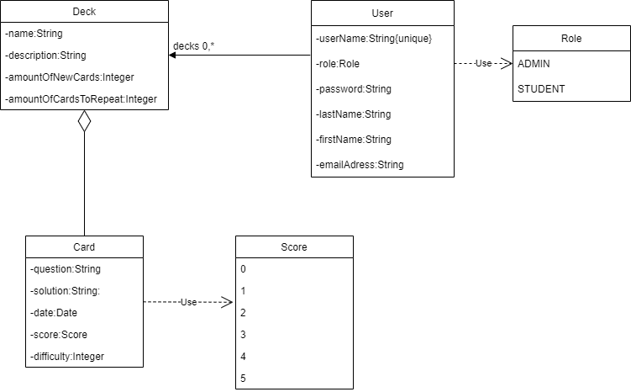

First scetch

Slide 5
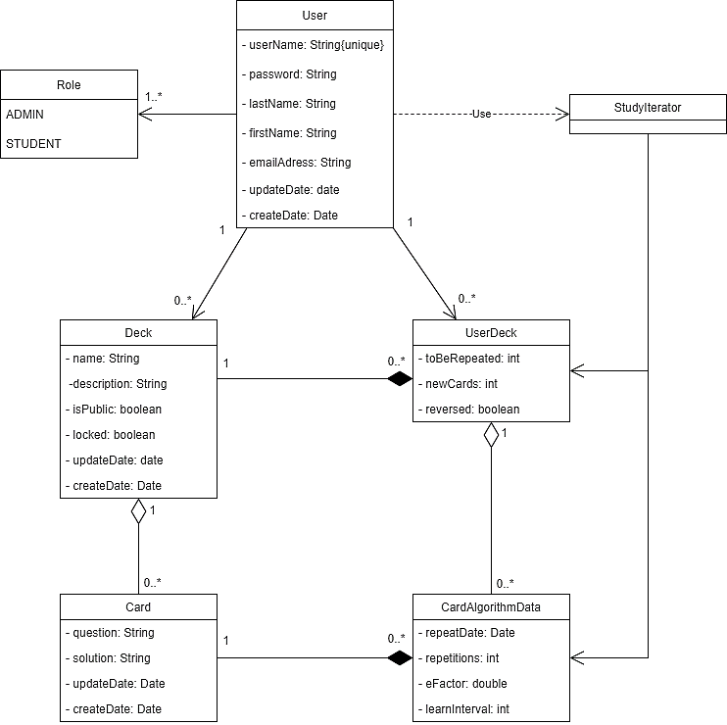
FiNal Diagram

Slide 6
JPA Auditing
What's it for? - Tracking of creation and modification timestamps
- Logging Users that made changes
How to use: - Simple way is to use Annotations on fields e.g:
@createDate, @createUser
- implement the AuditorAware class to track Users

Slide 7
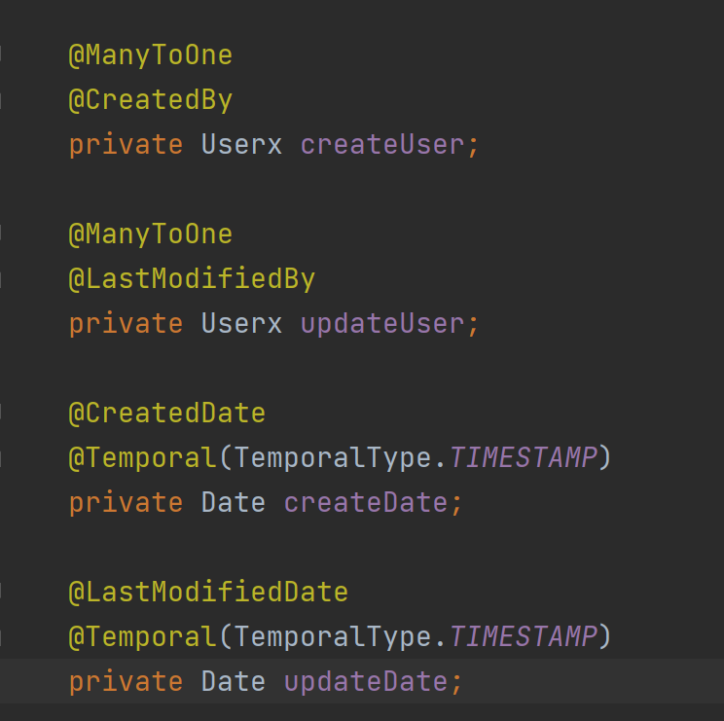
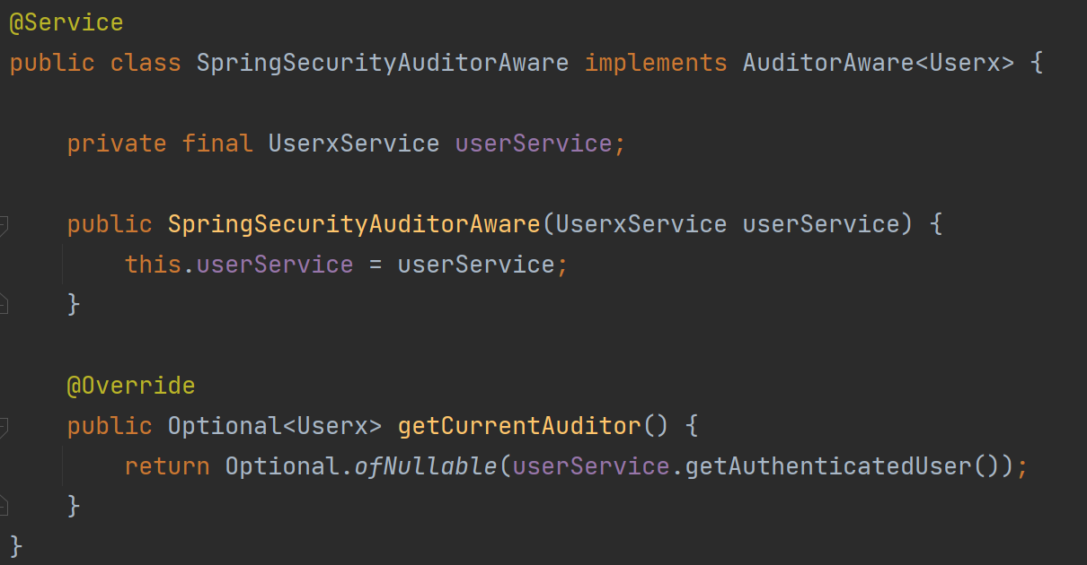
JPA Auditing Example

Slide 8


Search, Sort and Pageable
Search with the given Repository is simple:
But how do you sort?
- custom queries
- frontend using e.g JavaScript
- another way is to use a Pageable Object from Spring.
the repository allows for a paegable parameter in each method:
Advantages: - the Pageable Object can be given a Sort parameter
- You can configure the page request to only retrieve a certain number of Objects to reduce load

Slide 9
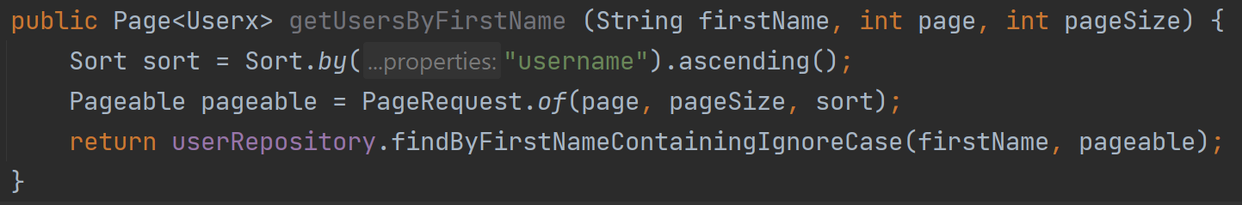
Pageable Example

Slide 10
Algorithm with Iterator
Why an Iterator? - we only need to show one card at a time
- we only need to implement next() and hasNext()
and a method to rate a card
Implementation: - uses a PriorityQueue in the Background, to prioritize already repeated cards over new ones
- has access to repository so it can update data while someone is studying

Slide 11

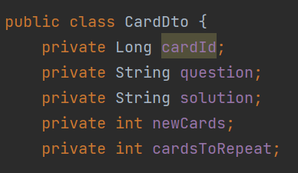
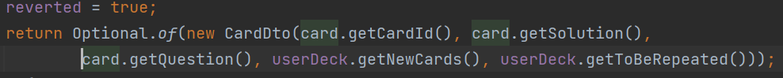
Revert Deck MODE
CardDto (Data transfer object)
Deck has boolean attribute „isReverted“.
- If deck is reverted then CardDto with changed places of „question“ and „solution“ returned

Slide 12
AdVantages and Disadvantages of sharing Decks
- to study or edit public decks, user needs to add it to his decks
-By adding public deck to his decks , it is saved with new unique ID
+ : changes in decks of users who added it not affect initial (public) one ;
-: In case of blocking initial (public) deck, the decks which was “copied” are staying
(which is also an advantage because we don’t
know how much copied deck has changed by user )

Slide 13
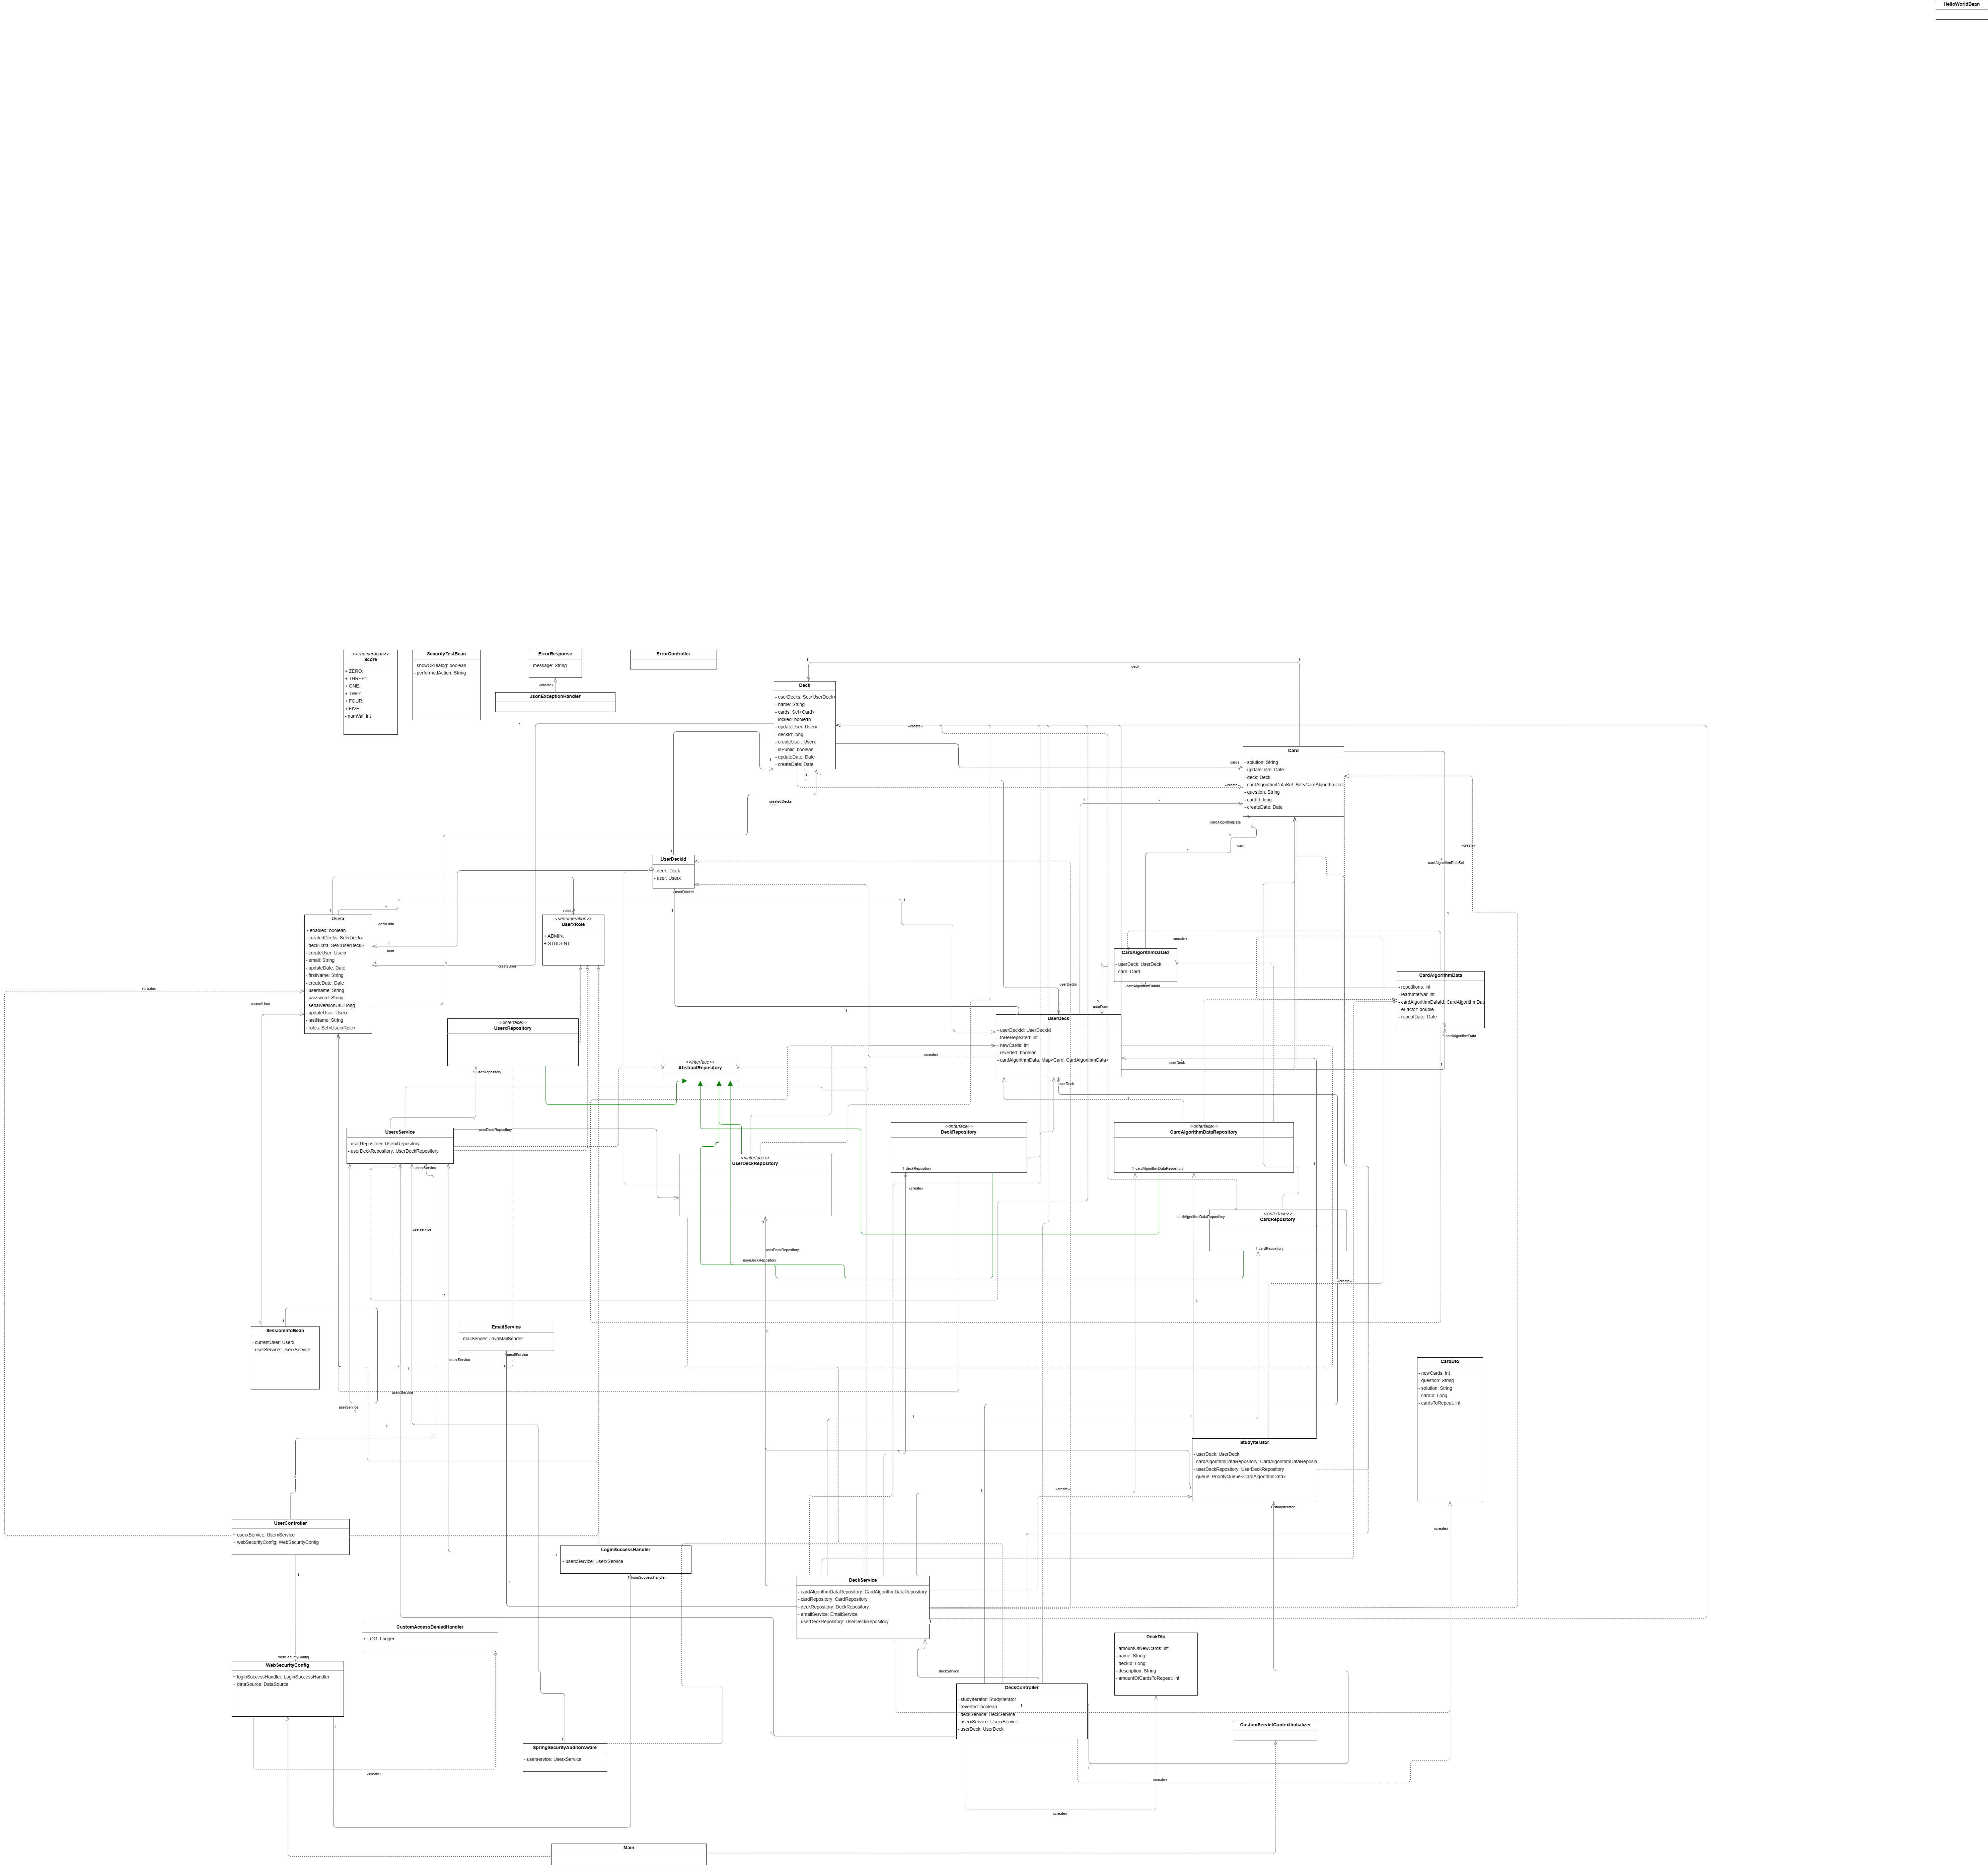
Resulting Diagram

Slide 14
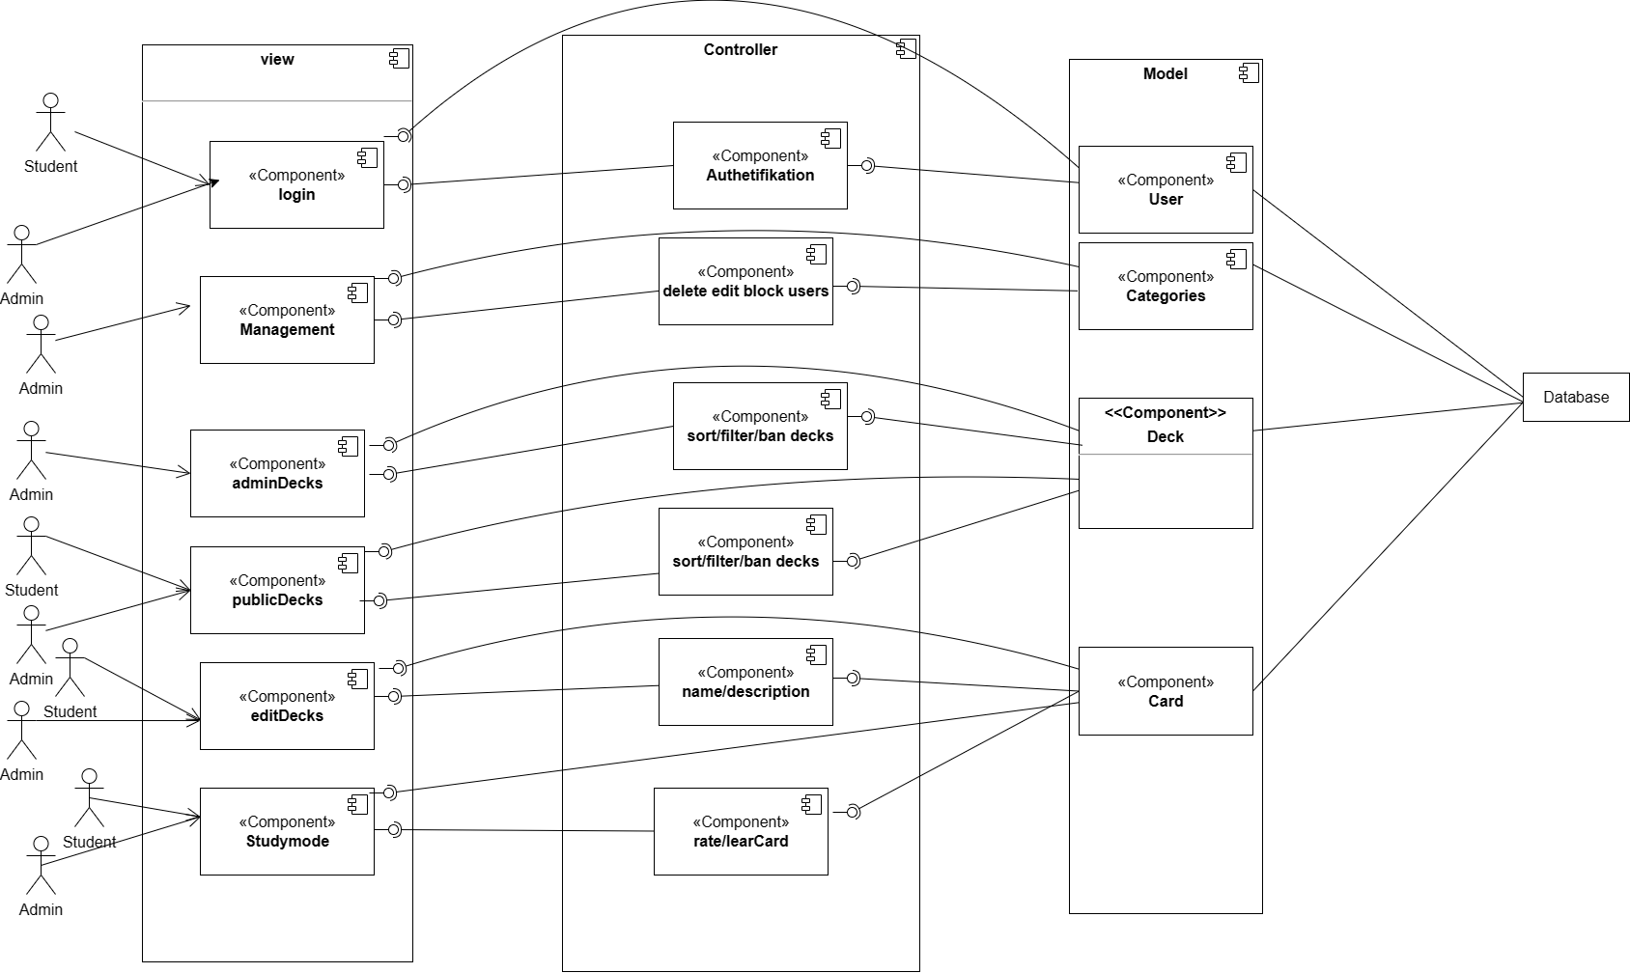
Distrubiution diagram

Slide 15
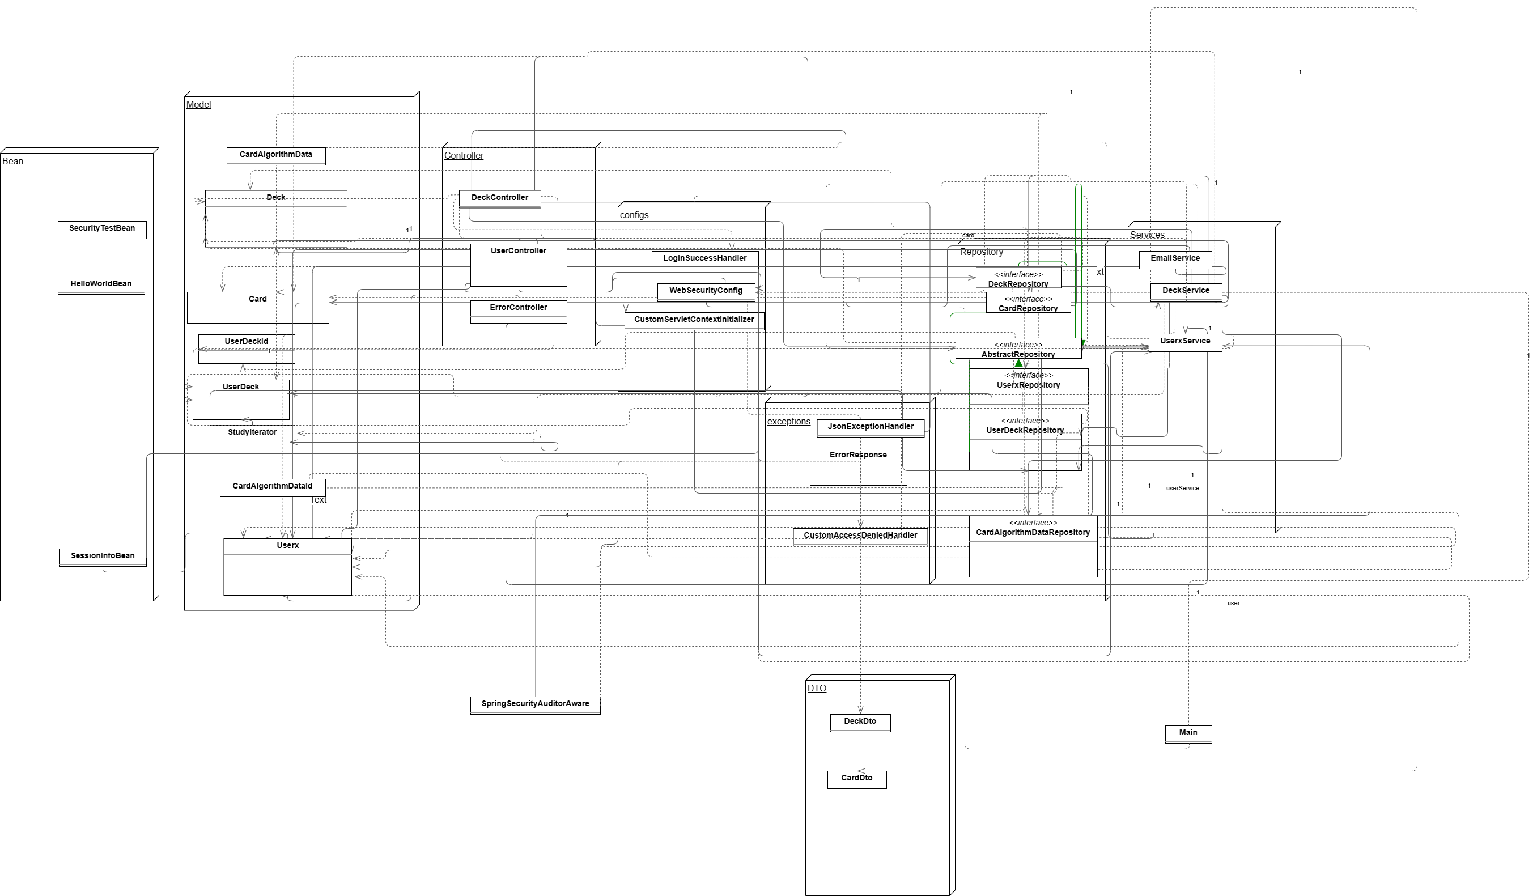
Component diagram

Slide 16
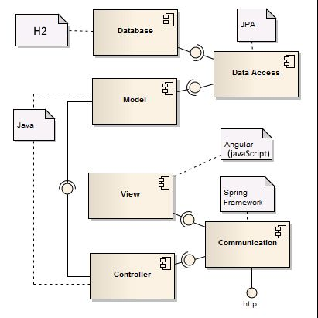
Simple version

Slide 17
Thank you For Your Attentation
Group 3

